Slide 1

LLMs and Their Pros and Cons
Exploring Language Learning Models

Slide 2
Agenda
Overview of LLMs
Pros of LLMs
Cons of LLMs
Applications of LLMs
Conclusion

Slide 3
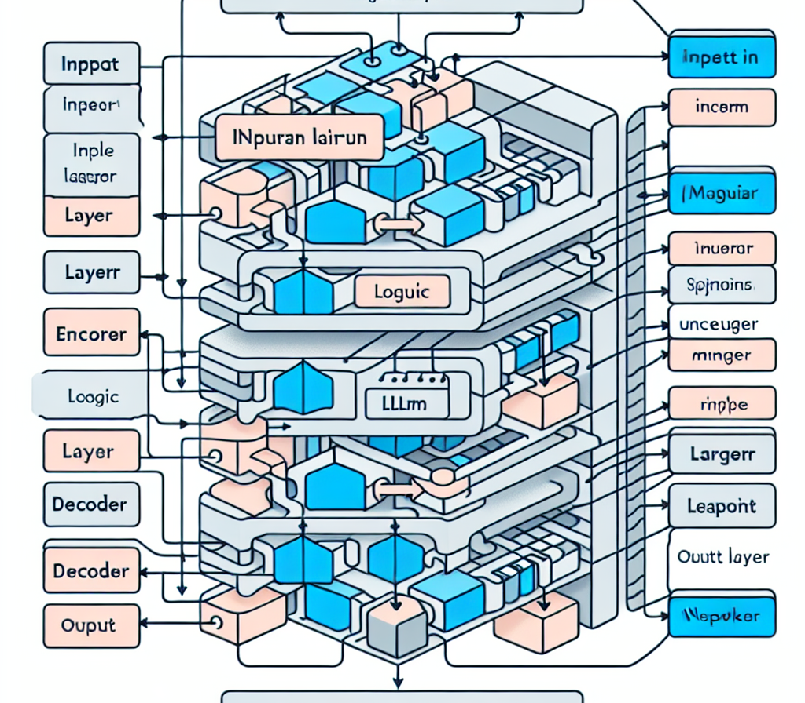
Overview of LLMs
Understanding Language Learning Models

Slide 4

Pros of LLMs
Advantages in Various Fields

Slide 5

Benefits of LLMs
Highly scalable and efficient
Advanced language understanding
Supports diverse applications
Enhances content creation and research
Facilitates human-like interactions

Slide 6

Cons of LLMs

Slide 7

Challenges of LLMs
Resource-intensive, requiring significant computational power
Potential for generating biased or misleading content
Lack of true understanding and context
Dependence on quality training data

Slide 8
Applications of LLMs
Need:
Continuous improvement in context understanding
Ethical considerations for AI usage
Monitoring for biased outputs
Adapting to user feedback

Slide 9
Conclusion
Emphasizing user understanding and accountability
Shaping the future of AI-driven communication
Balancing innovation with responsibility

Slide 10
Future of LLMs
Evolving towards more conversational AI
Bettering understanding of human language nuances
Integration in everyday applications and tools
Expected advancements in LLM technology over the next decade

Slide 11
Financial Implications
Overview of industry investment in LLM technologies

Slide 12
Summary
With ongoing improvements and ethical considerations, LLMs can reshape industries and enhance user experiences.

Slide 13
Thank You
For your attention and questions!

